Slide 1

Have Streaming Services Killed movies?
Group #4: Bethany, Rohith, Velindia, Vlad

Slide 2
Motivation
The overall quality of cinema movies has declined (based on viewer and critic ratings). This project evaluates the decline in movies available across all platforms and if it is declining as expected, and if so, what are some possible reasons for the decline?
Notes:
Define the core message or hypothesis of your project.

Slide 3
Motivation- Question #1
Has the quality of movies declined over time?
Quality is determined by ticket sales and movie ratings by viewers. In order to prove our claim, we must establish a decline in the ticket sales and viewer ratings.
Notes:
Describe the questions you asked, and why you asked them

Slide 4
Motivation- Question #2
Is the increase in streaming services and other viewing alternatives associated with a decrease in overall cinema quality?
A part of our claim is that there is a relationship between the decline in the quality of cinema movies and growth of alternative entertainment sources such as Netflix and other tv programming.
Notes:
Describe the questions you asked, and why you asked them

Slide 5
Motivation- Question #3
What trends are shown between different genres as it relates to quality of movies?
This question gives us additional information on the breakdown of trends by genre so we can find out if there may be a specific genre(s) that are heavily contributing to the decline in movie quality or vice versa.
Notes:
Describe the questions you asked, and why you asked them

Slide 6
Summary
We were able to get sufficient information to answer our question, as this information is readily available on the internet. Although we saw a drop in movie ratings and a rapid growth of online streaming services such as Netflix in the last decade, there was not enough evidence to conclude that the growth of streaming service is the reason for this decline.
We observed that movies ratings have been steadily declining since 2007 while TV series ratings have been consistently increasing over the same period.
We also noted that the average number of movie tickets sold per person and annual box office revenue have been decreasing since 2003.
Finally, we observed the shift in genres popularity over the last 20 years. We noted large increase in Action and Adventure movies produced and large decrease in Dramas and Comedies.
Notes:
Describe whether you were able to answer these questions to your satisfaction, and briefly summarize your findings

Slide 7
Question #1
Has the quality of movies declined over time?
To answer this questions, we needed a yearly count of how many tickets were sold and the average percentage of viewer and critic rating by year. We used viewer ratings from Rotten Tomatoes and pulled critic ratings from OMDB.
Notes:
Elaborate on the questions you asked, describing what kinds of data you needed to answer them, and where you found it
Data Analysis-Discuss the steps you took to analyze the data and answer each question you asked in your proposal
Present and discuss interesting figures developed during analysis, ideally with the help of Jupyter Notebook

Slide 8
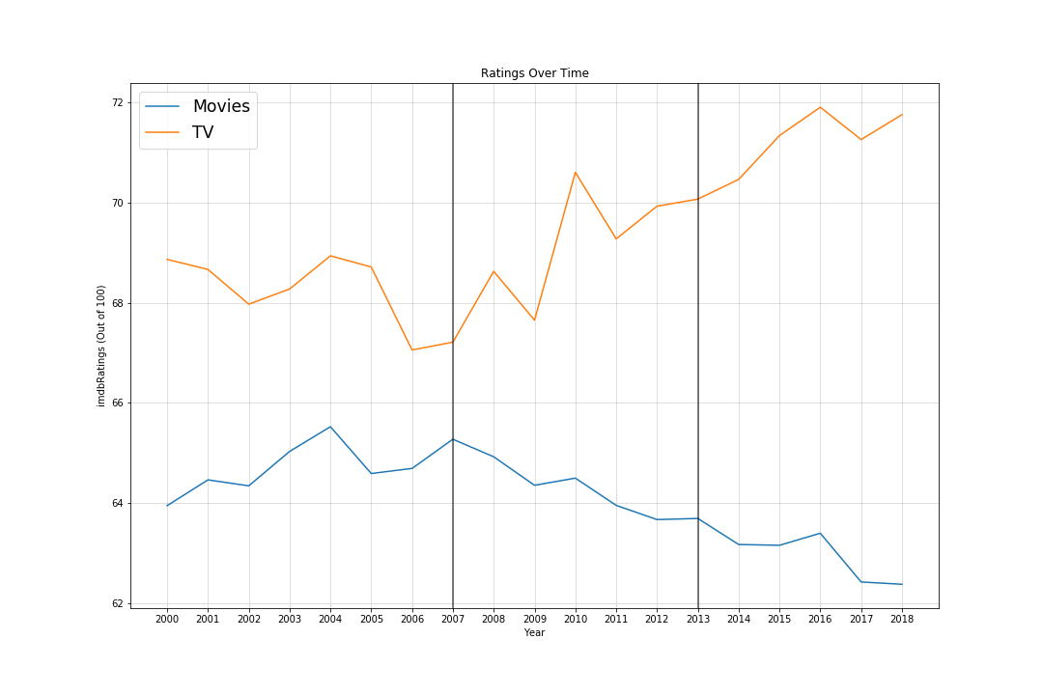
Changes In Movies vs TV Ratings
First, the average ratings from Imdb were graphed by year starting from 2000 and continuing through 2018. vertical lines represent the approximate years that Netflix began to offer streaming and released their first original series. The data shows that the tv ratings have a positive trend, while movies have a negative one.

Slide 9
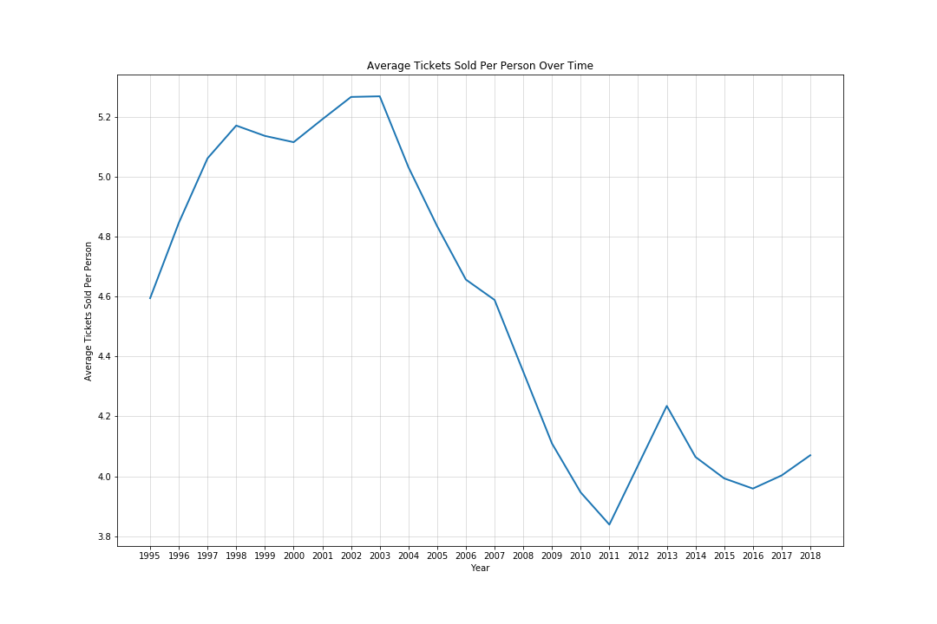
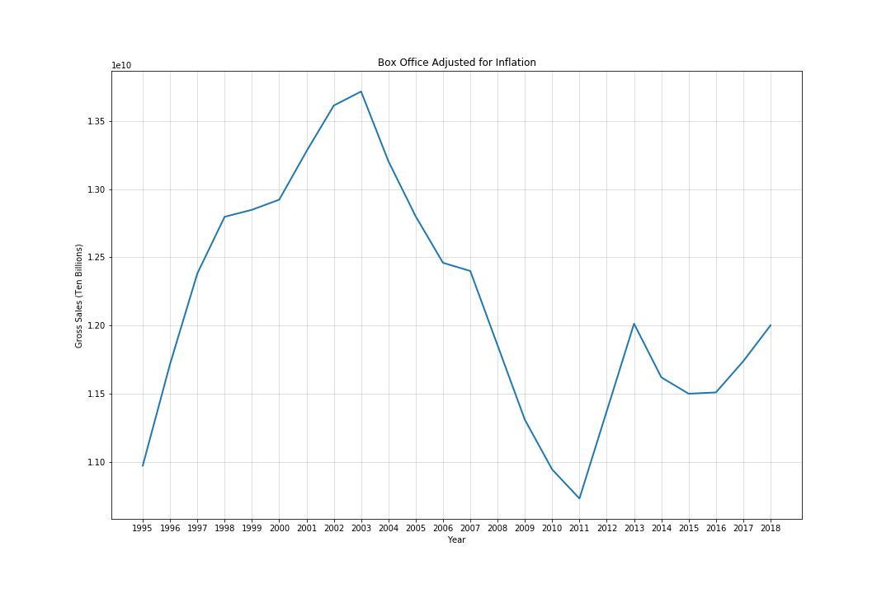
Avg Number of Tickets Sold
Box Office Sales Adjusted For Inflation
There is a similar trend between the average number of tickets sold and the box office sales adjusted for inflation. It shows a peak for each around 2003 before declining to a low in 2011.

Slide 10
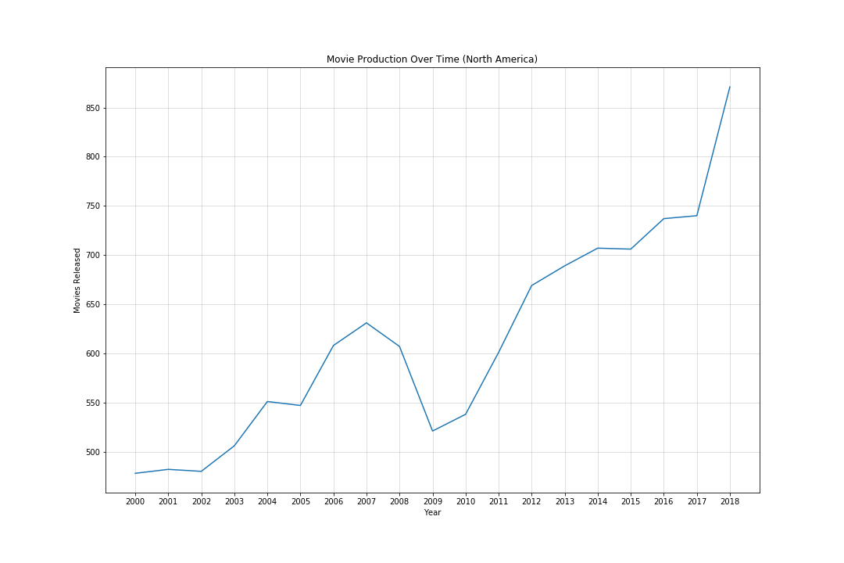
Movie Production 2000-2018
Because of the limitations in the OMDB dataset and to ensure accuracy, an pre-aggregated statistic was used to show the Movie releases over the same period. The number of movies produced has greatly increased since 2000.

Slide 11
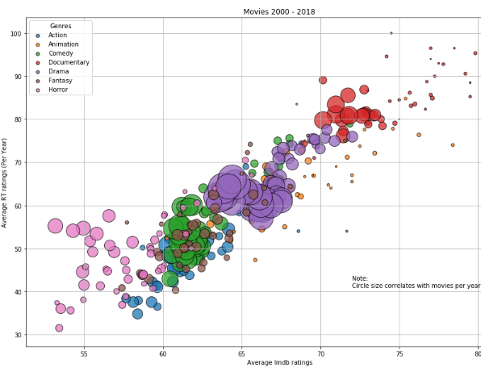
Viewer & Critic Breakdown 2000-2018

Slide 12
Question #2
Is the increase in streaming services and other viewing alternatives associated with a decrease in overall cinema quality?
This question will tell us if consumers are choosing alternate entertainment sources, like Netflix and TV programs more frequently and if they choose these forms of entertainment over cinema viewing. This will determine if there is a correlation between the decline in movie quality and increase in quality of other entertainment sources.
Notes:
Elaborate on the questions you asked, describing what kinds of data you needed to answer them, and where you found it

Slide 13
Changes In Movies vs TV Ratings
First, the average ratings from Imdb were graphed by year starting from 2000 and continuing through 2018. vertical lines represent the approximate years that Netflix began to offer streaming and released their first original series. The data shows that the tv ratings have a positive trend, while movies have a negative one.

Slide 14
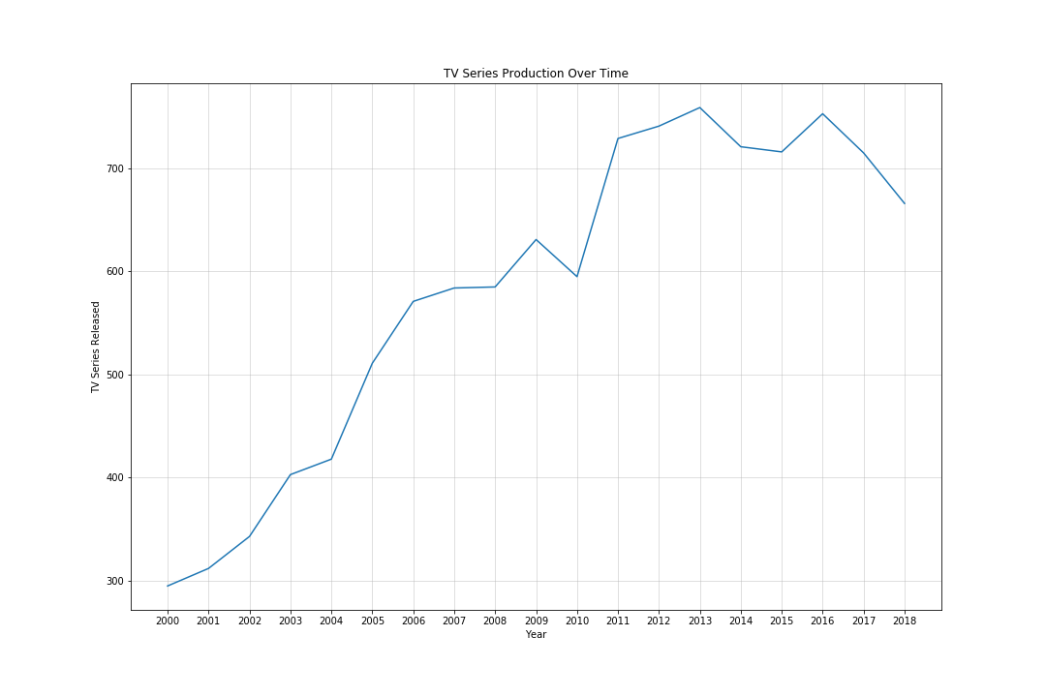
TV Series Production 2000-2018
TV series data was next grouped by year and year and tv count plotted to show change over time. We see that there is an increase in the number of tv series produced since 2000.

Slide 15
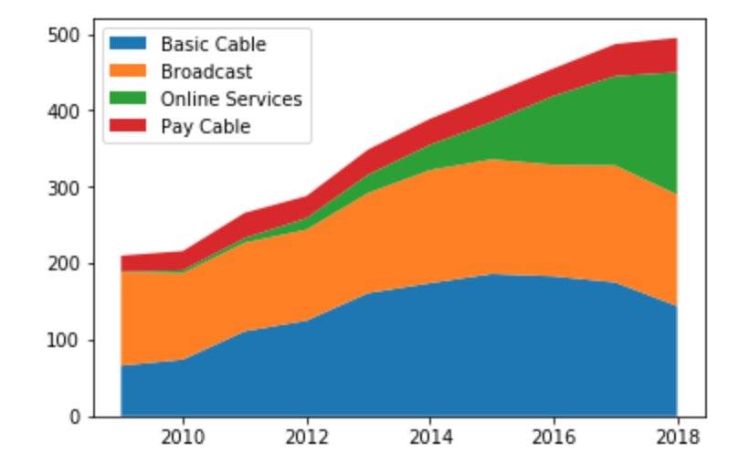
Breakdown of TV series by channel
First Online Services TV series was produced in 2009 and it it has been rapidly increasing since then.

Slide 16
Question #3
What trends are shown between different genres as it relates to quality of movies?
We looked at the percentage of movies for each genre that were released per year as well as the ratings by genre to determine if there are negative trends in specific categories. This would break down the decline in quality of movies in a way that determine which the genres are compared to overall trend
Notes:
Elaborate on the questions you asked, describing what kinds of data you needed to answer them, and where you found it

Slide 17
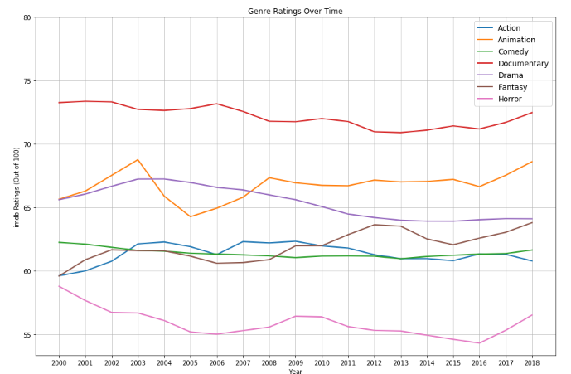
Genre Ratings 2000-2018
Ratings were further broken out to determine if any trends could be observed. This was achieved by grouping the cleaned genre data by genre and year and plotting against mean imdb ratings after some minor data munging using unstack and list comprehension to rename the columns

Slide 18
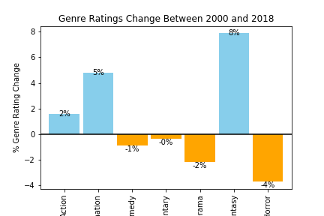
Changes in Genre Ratings
To confirm if there were any large changes in genre ratings, the percentage change between 2000 and 2018 was calculated and visualized with a bar graph.

Slide 19
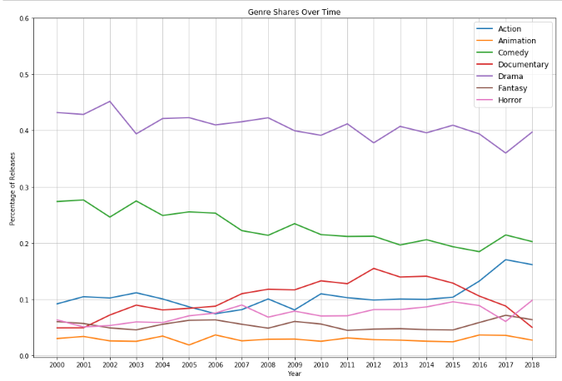
Genre Shares 2000-2018
The genre dataset was grouped by genre and year and divided by total per year to produce a change overtime.

Slide 20
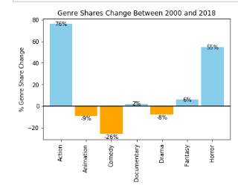
Change in Genre Shares 2000-2018
The percentage change was visualized in a bar graph to check for noticeable shifts.

Slide 21
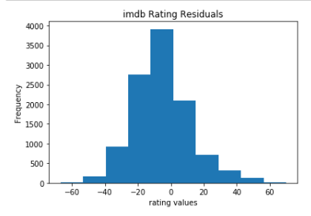
Imdb Rating Residuals

Slide 22
Data Cleanup & Exploration
The bulk of the data used for this project was retrieved from the OMDB API through a series of calls
The imdb titles in the first call was taken from a list of movies posted on kaggle.com and formatted before being placed in a list and called with a for loop that built a dataframe from the data retreived from the API. After closer examination of the dataset it was it was decided that the data still desired included details on tv series and movies from the year 2018 as the kaggle csv included neither. These titles were downloaded from imdb as a tab separated and gzipped file.(tsv.gz) The gzip and shutil libraries were used to unzip the files and save as csv files so they could be read into the notebook as a dataframe. The imdb file with IDs and votes was combined to complete the list for the second and third API calls.
Notes:
Describe the exploration and cleanup process. Discuss insights you had while exploring the data that you didn't anticipate
Discuss any problems that arose after exploring the data, and how you resolved them
Present and discuss interesting figures developed during exploration, ideally with the help of Jupyter Notebook

Slide 23
Data Cleanup & Exploration (cont.)
The OMDB data was cleaned by correcting the formats of both the rotten tomatoes and imdb ratings so they were consistent for easy comparison.
Because most movies had multiple genres stored as a comma seperated string, some work needed to be done to narrow down what was included for analysis purposes. Each row was first split and expanded to have each genre on its own column and run through a loop to collect a list of unique genres. The resulting list of genres was narrowed from 23 to 7 to make a succinct analysis possible.
In addition to the above data, aggregated data was retrieved from several sources to aid in answering additional questions that arose during the course of analysis.
Notes:
Describe the exploration and cleanup process. Discuss insights you had while exploring the data that you didn't anticipate
Discuss any problems that arose after exploring the data, and how you resolved them
Present and discuss interesting figures developed during exploration, ideally with the help of Jupyter Notebook

Slide 24
Discussion
We expected to find a clear decline in movie quality and a correlation between the decline and the rise of other entertainment sources such as Netflix. However, this is not what we found. Although we saw a drop in movie ratings and a rapid growth of online streaming services such as Netflix in the last decade, there was not enough evidence to conclude that the growth of streaming service is the reason for this decline.
We observed the shift in genres popularity over the last 20 years. We noted large increase in Action and Adventure movies produced and large decrease in Dramas and Comedies. We concluded that the shift in genres popularity may be the reason for perceived drop in quality of movies.
Notes:
Discuss your findings. Did you find what you expected to find? If not, why not? What inferences or general conclusions can you draw from your analysis?

Slide 25
Limitations/Difficulties
Initially, there was difficulty gathering information. Most sites required a fee to access data or limited how much data that could be accessed for free, thus restricting our options for data sources.
We discussed how to best analyze movie genres when a single movie could be categorized as 10 different genres. We went with a method that would count the 1 movies within each genre listed, thus skewing the data.
Notes:
Discuss any difficulties that arose, and how you dealt with them

Slide 26
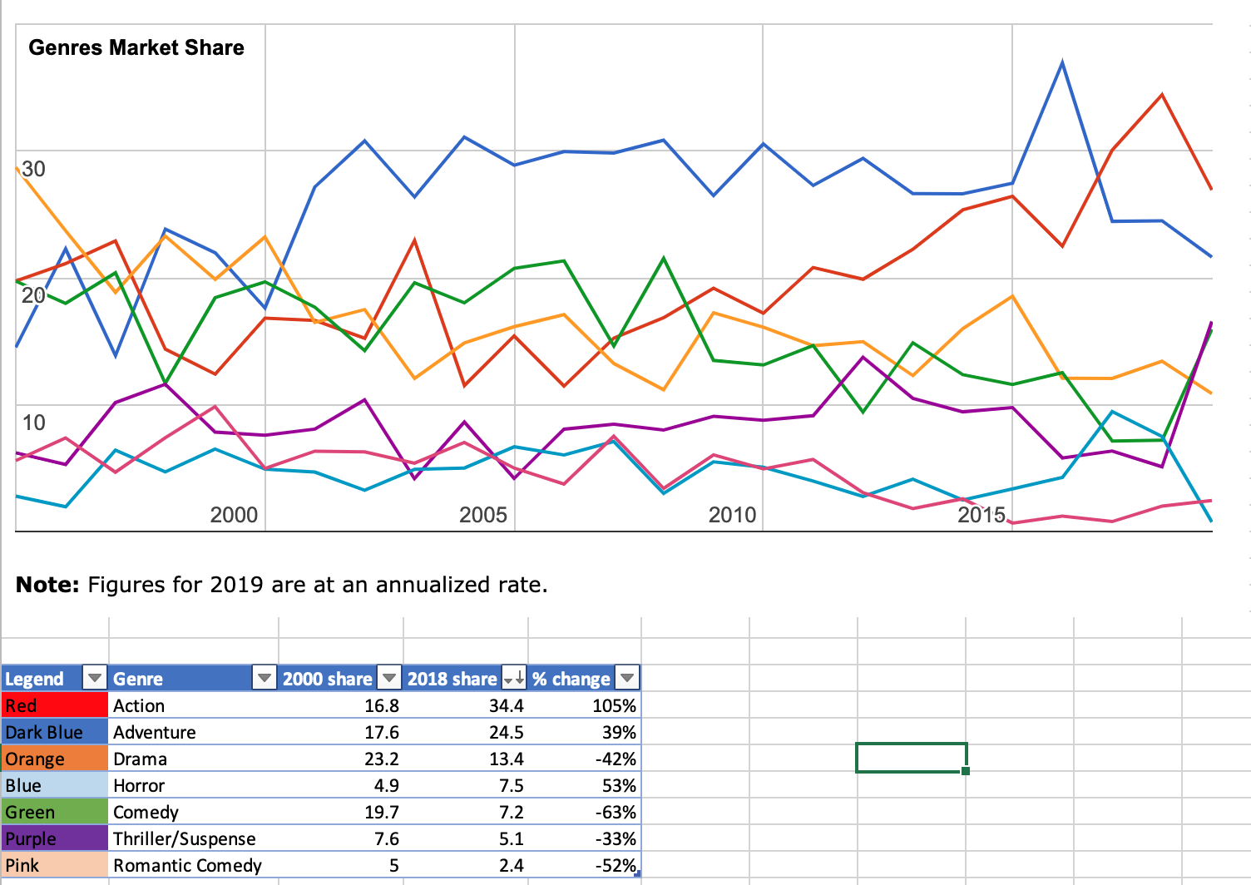

Slide 27
Additional Questions/ Extensions
What is quality of movies based on studio?
Are there trends among viewers of a certain age in regards to their approval rating?
Notes:
Discuss any additional questions that came up, but which you didn't have time to answer: What would you research next, if you had two more weeks?

Slide 28
Questions?

